Slide 1
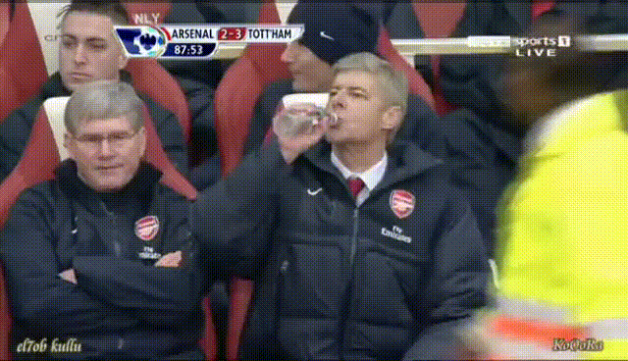
“I get nervous before the games because football (soccer) is not mathematics.”-Arsene Wenger, Former Arsenal’s Manager
Notes:
Add arsene wenger’s pic [you can isnert it} [add arsene wenger’s angry picture!!!] the one with the bottle. “
Sometimes, I feel like the guy in the righ hand side, when my predictions for a soccer game tursn out incorrect! He is Arsene wenger, one of the best managesrs during his time… and he once quoted….

Slide 2
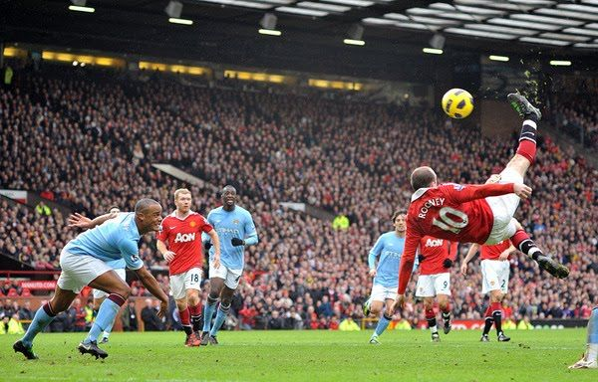
Playing the Odds: Accurately Predicting Soccer Games In English Premier League Using Ordered Probit Models and Artificial Neural Networks
Presenter: Shivam K C Advised By: Dr. Colby Long
Notes:
E: Add some pictures!

Slide 3

Outline
Introduction
Data
Methods
Results
Strengths & Limitations
Future Work & Conclusion
Notes:
In introduciont, I will talk about the what and the why of my research.; in methods, I will talk about Probit model and briefly touch upon ANN;
E: add pictures

Slide 4

The IS Goal!
Build mathematical models
To predict English Premier League (EPL) soccer games
With predictive accuracy higher than 54.6%
Notes:
What is the prupose behind my research? And why? 54.6%?

Slide 5
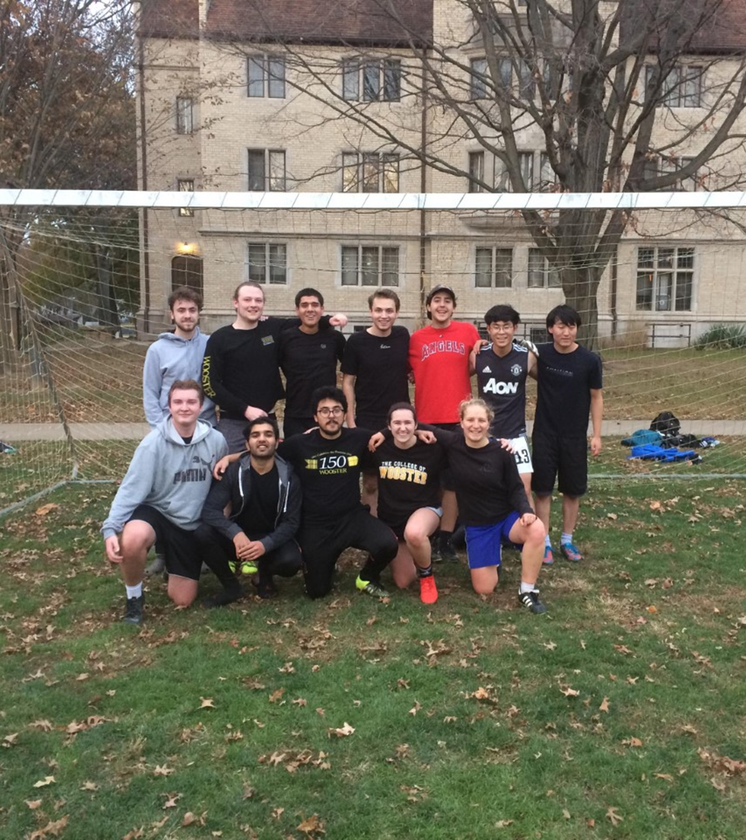
Purpose for My IS
I LOVE SOCCER!!!
A gut instinct
Notes:
Combining my passion for soccer and data analysis
While applying to the College of Wooster and learning about the IS, I told myself that I will predict soccer games for my IS.

Slide 6
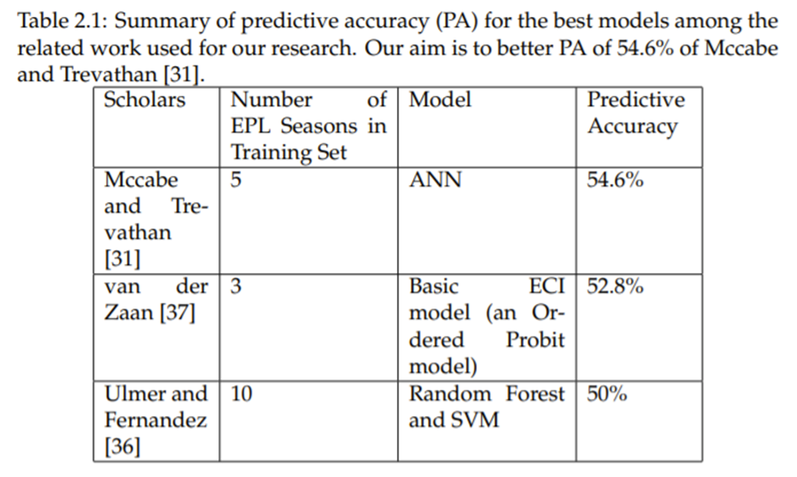
Why 54.6%?
It is the highest predictive accuracy among related work
Notes:
Include the table of PA here!!!
Should I be cautious here?

Slide 7

Data
Kaggle dataset: “European Soccer Database”
8 seasons (2008/09 – 2016/17) worth of EPL data
No. of cleaned observations used: 2640
No. of cleaned variables used: 22
Notes:
Focused on EPL

Slide 8
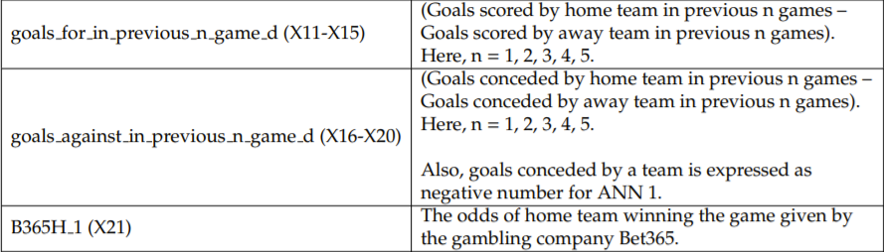
Examples of Variables
Dependent Variable: match_outcome (H, D, A)
Predictors:

Slide 9

Methods
Ordered Probit Model
Artificial Neural Network (ANN)
Baseline Models
Notes:
Our proposed models are:
I will talk about how the ordered probit model works and briefly touch upon ANN models
Introduce our baseline models

Slide 10
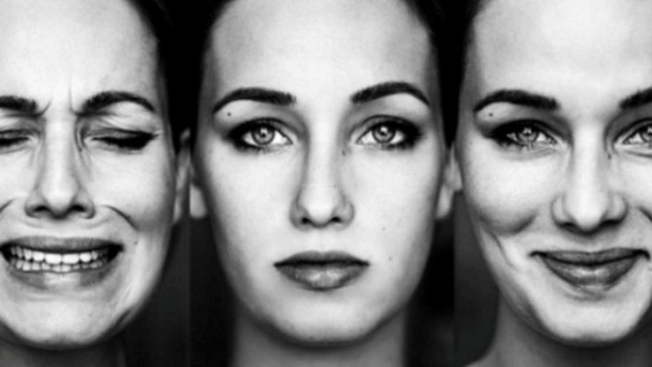
Ordered Probit Model
Unlike in logistic regression (only 2 categories), the dependent variable will have 3 or more categories
We assume they have an unambiguous ordering (i.e., not nominal data). A < D < H
The idea is as one variable increases, it would result in a shift toward either end of the spectrum of ordinal responses

Slide 11
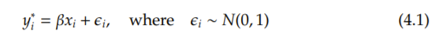

Ordered Probit Model
An unobserved latent variable,${ y}^{∗}$, is incorporated by the ordered probit model
The model consists of explanatory variables, given by $x_{i}$, related to the clubs competing in a match $i$
Under the assumption of fixed predictors, $y_{i}^{∗}$ is normally distributed and linearly related to $x_{i}$
Notes:
Latent variable…we can’t see it. So, we can assume lot of things about it. The idea behind latent variable is that as you respond more highly on latent variable, you respond more highly on the ordeinal scale.

Slide 12

Ordered Probit Model: Example
A match between two teams that are equally matched
Theoretically, match should be a draw
But, unexplained factors, such as luck, change match outcomes
Notes:
To understand how the value of y ∗ i varies per match, let’s take an example of a match between two teams that are equally matched they have the exact same history, qualities, and are playing at a neutral venue

Slide 13
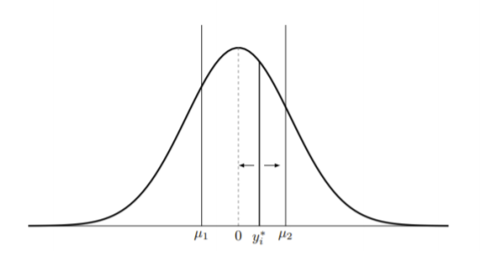

Ordered Probit Model: Example
In every match, the values of $y_{i}^{∗}$ change
Values of ${\text{µ}}_{1}$ and ${\text{µ}}_{2}$ remain unchanged for a season
Because past seasons’ data are used to estimate these parameters
For each match, the outcomes of home win, away win, and draw will be given certain probabilities by the model
Notes:
The normal distribution of y ∗ i is depicted on Fig. 4.1, which also shows how y ∗ i differs in each match depending on team and match variables.
The probabilities are the area under the curve.

Slide 14
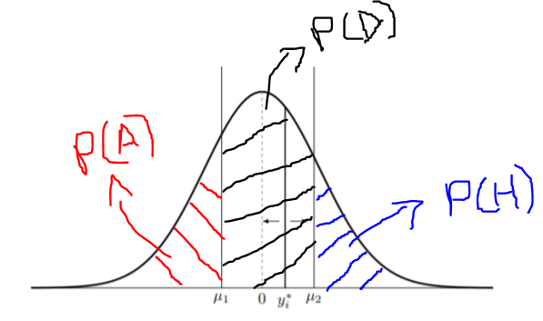
Ordered Probit Model: Example
P(H) = P(A)
Notes:
To come back at the previous mentioned example of a match between two clubs with equal characteristics.
The corresponding latent variable, y∗I follows a normal distribution with equal chances assigned to the occurrence of a home win and an away win.
The area under the graph is the probability!

Slide 15
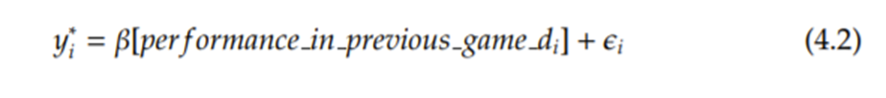
Ordered Probit Model: Example
performance_in_previous_game_d
difference in the home team’s performance and the away team’s performance in their last games
performance: Win (3), Loss (0), and Draw (1)
Notes:
If we use performance in previous game d, difference in the home team’s performance and the away team’s performance in their last games (see Table 3.1), as the explanatory variable in our model, the latent variable y ∗ i will be as follows:

Slide 16
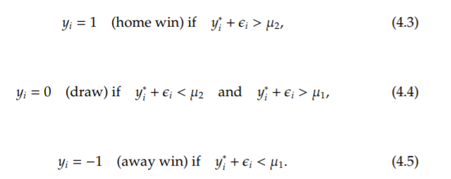
Ordered Probit Model: Example
performance_in_previous_game_d = 0
Let the ordinal response of the match outcome be {1, 0,−1}
Notes:
As a reminder, we are assuming here that the home team and the away team are equally matched.
Then, the following equations show how the latent variable and threshold values relate to each other:
“If time, I can add how the probabilities are calculated!”

Slide 17
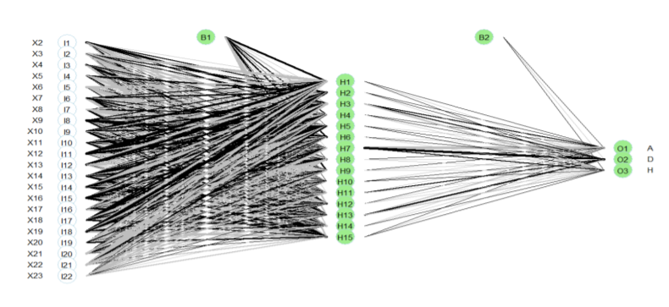
Summary of ANN
nnet function from nnet package in R Studio
Multi-Layer Perceptron (MLP) learning algorithm
Softmax activation function
Notes:
MLP assigns a weight to each input variables based on that variable’s significance in the model.
which is often placed at the output layer of a neural network. This function turns a vector of K real values into a vector of K real values that sum to 1, so that they can be interpreted as probabilities
This figure shows the structure of our ANN model. There are 22 input variables (as described in Table 3.1), one hidden layer with 15 nodes, and 3 outputs. B1 and B2 are pointing to the weights being used in the model.

Slide 18
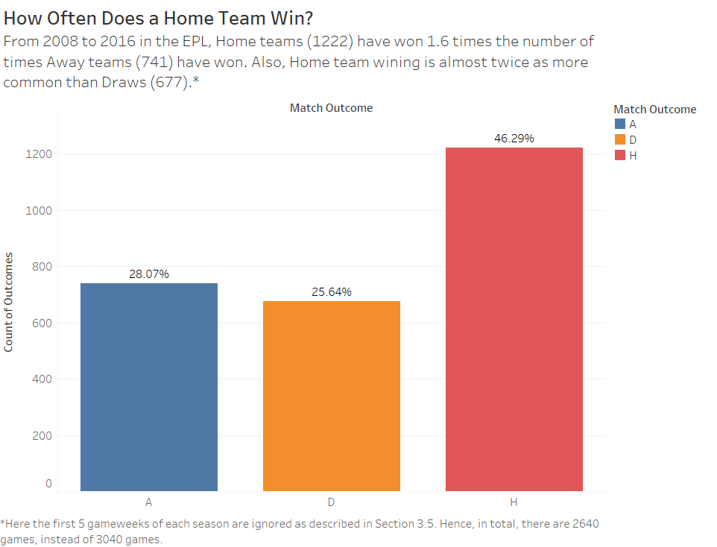
Baseline Models: Simple Baseline Model
Home Teams Always Win
Predictive Accuracy (PA): 46.3%

Slide 19
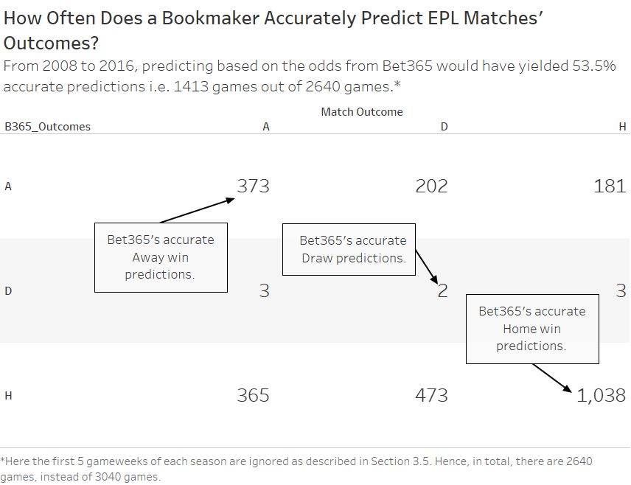
Baseline Models: Bookmaker Baseline Model
Based on bookmaker’s odds converted to probabilities
Predictive Accuracy (PA): 53.5%
Notes:
the outcome with lowest bookmaker’s odds will be predicted by this baseline model

Slide 20

Results
Initially, how do our models perform?

Slide 21
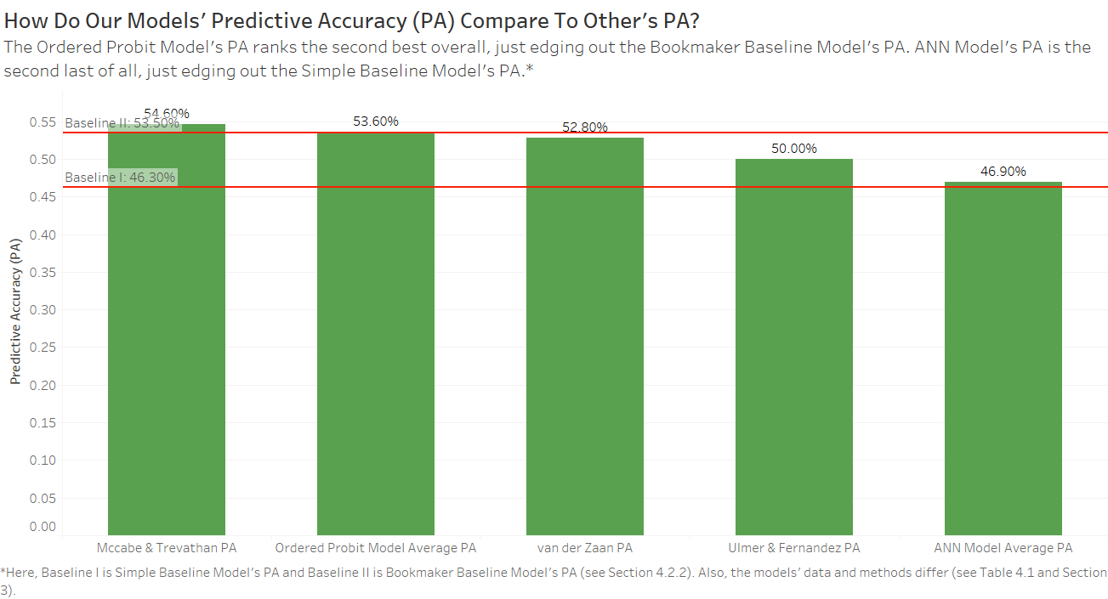

Slide 22
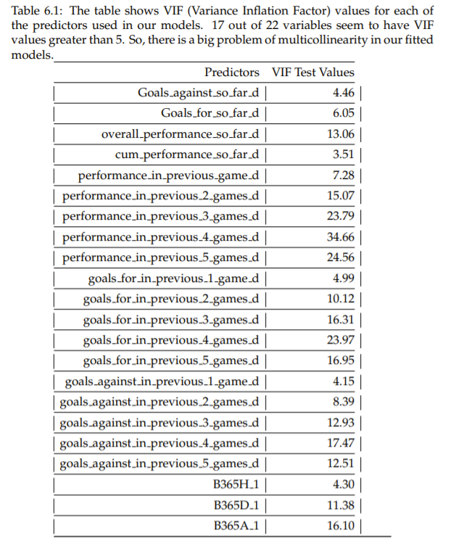
But, Multicollinearity!
Significant correlation between the predictor variables
Statistical significance of a predictor in a model is undermined
Example: performance_in_previous_4_games_d ~ goals_for_in_previous_4_games_d
Notes:
Multicollinearity is a condition when there is a significant correlation between the predictor variables
For instance, in our model, performance in previous 4 games d could highly correlate with goals for in previous 4 games d because if a home team has been winning more games than an away team in their last 4 games, then the home team is likely to have scored more goals than the away team in their last 4 games.

Slide 23
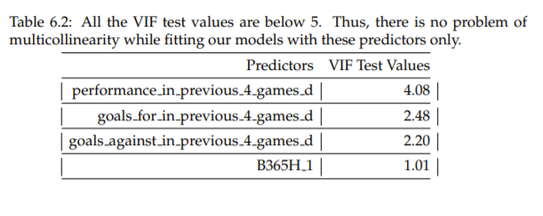
Overcoming Multicollinearity!
Experimented with using only 4 predictors
Multicollinearity has been reduced. Results?
Notes:
, we experimented with using only 4 predictors in both our modelsl
However, this is not an ideal choice because it is strange to use statistical significance from the model in which we are trying to correct the misleading results. But, we did this because we were short on time and thought this was a good starting place to experiment

Slide 24
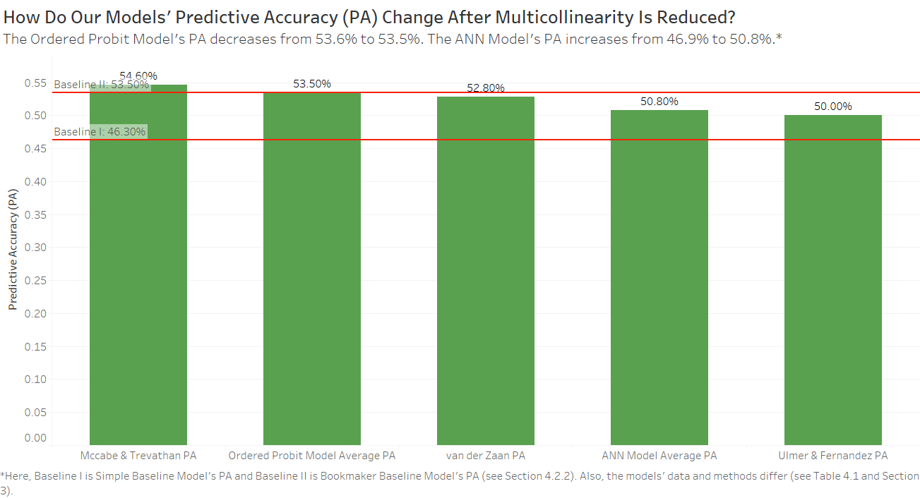

Slide 25

Limitations
1. Our models are heavily reliant on betting odds
What happens to our models’ average PA when B365H_1 is removed as a predictor?

Slide 26
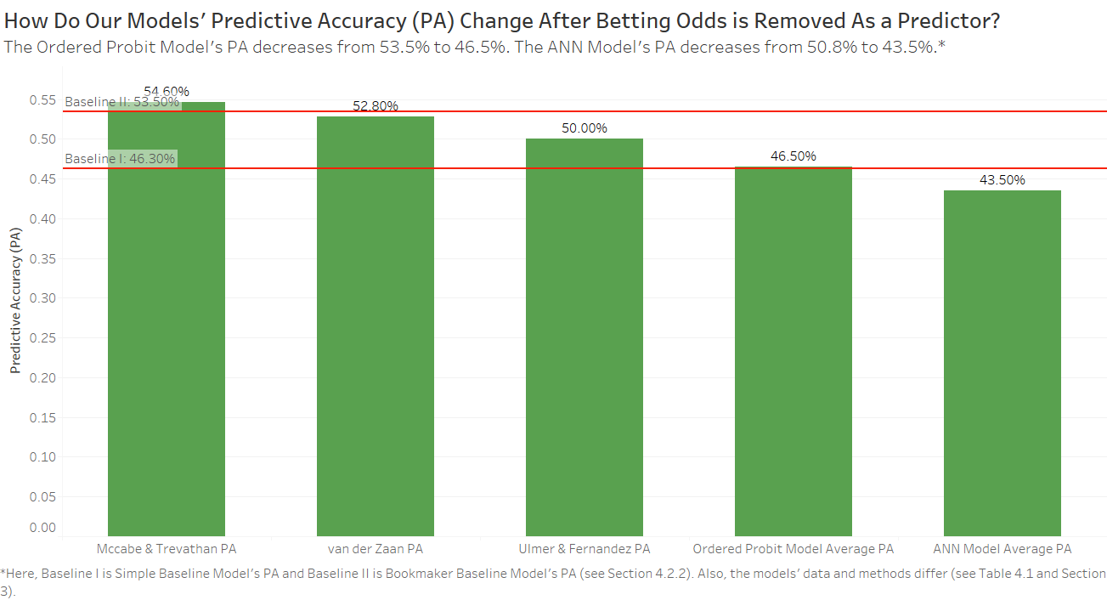
Notes:
People can consider this a limitation because they would question our use of a bookmaker’s model’s outcomes as one of our predictors in our models
But we believe that in order to predict soccer games’ outcomes even more accurately, we need to experiment with every variable available

Slide 27
Limitations
2. Unable to generalize for other soccer competitions
Interesting to see what kind of results can be obtained doing similar research for other soccer leagues.
Notes:
The focus of our research is to predict soccer games in the English Premier League (EPL). Thus, it makes sense that our results can only be generalized for EPL.

Slide 28
Strengths
Preferred models have higher PA than the simple baseline model
Multicollinearity is considered
Preferred models are simple
Notes:
Our preferred models are the models with 4 vars after multicoolliniery has been reduced
An achievement of our analysis is that both models show PA higher than the simple baseline model’s PA. Additionally, the ordered probit model’s PA does tie with the bookmaker baseline model’s PA at 53.50%.
This reduction in multicollinearity clearly improves the simplicity and the average PA of our models
Consequently, our preferred models are simpler and easier to interpret. They only have 4 predictors, but their PA are among the best in our related work

Slide 29

Future Work
1. Tweak our models’ parameters
Build an ANN model with 3 hidden layers and 10 nodes for each layer, just like Mccabe and Trevathan did
Notes:
. The reason why is that Mccabe and Trevathan’s model does a really good job predicting soccer games without using betting odds as one of their predictors
We attempt to build a similar ANN model as they did. However, the output from the model is not what we expected. Hence, we build a simpler ANN model that gives sensible outputs. So, future research could investigate this issue

Slide 30
Future Work
2. Use a different metric to compare the models
Instead of using PA, likelihood can be used to compare models
It will either reward or punish a model for assigning higher probabilities for an accurate outcome or an inaccurate outcome, respectively
When two models have similar PA, likelihood can be used to differentiate them
Notes:
Usually, likelihood will either reward or punish a model for assigning higher probabilities for an accurate outcome or an inaccurate outcome, respectively

Slide 31
Future Work
3. Build models with other confounding variables
Euro Club Index (club ratings)
Whether a match is a regional derby or not (rivalry)
Effect of national cup matches (team’s fixtures), etc.
Notes:
Usually, likelihood will either reward or punish a model for assigning higher probabilities for an accurate outcome or an inaccurate outcome, respectively

Slide 32
Future Work
4. Do data transformation and use different combinations of predictors
Notes:
Future studies could investigate transforming input variables based on their relationship with the output variable. Also, different combinations of predictors can be used to see how well a model predicts.

Slide 33

To Sum Up
We aimed to predict EPL soccer games with PA higher than 54.6%
Built several ordered probit models and ANN using EPL data from 2008/09 to 2016/17 seasons
An ordered probit model with 4 predictors had an avg. PA of 53.5%
An ANN model with 4 predictors had an avg. PA of 50.8%
Results suggest building more complex ANN model may be the key
Notes:
The results show that a simple statistical model comes closest to reaching the target set by a complex ANN model:
These results suggest that if we want to build a model with higher PA, which does not rely on betting odds data, then building more complex ANN model may be the key: specifically, building ANN models with more hidden layers and nodes.

Slide 34
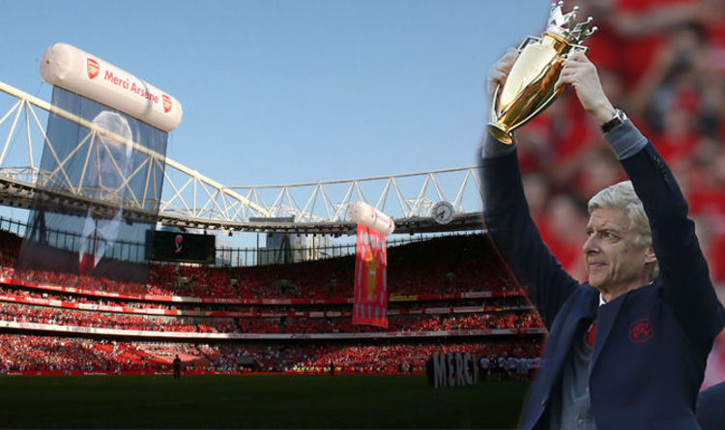
Thank You!
Notes:
Like a champagne of Arsene wenger and mine collage?

Slide 35
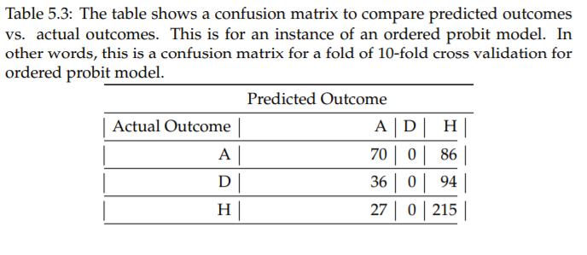
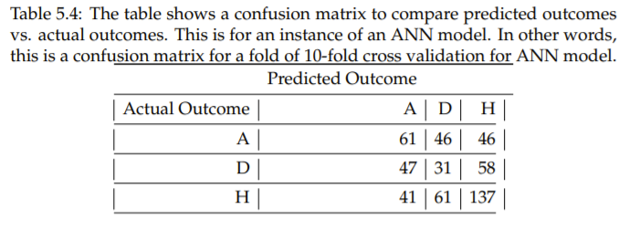
Should Ordered Probit Model Predict Draw?

Slide 36
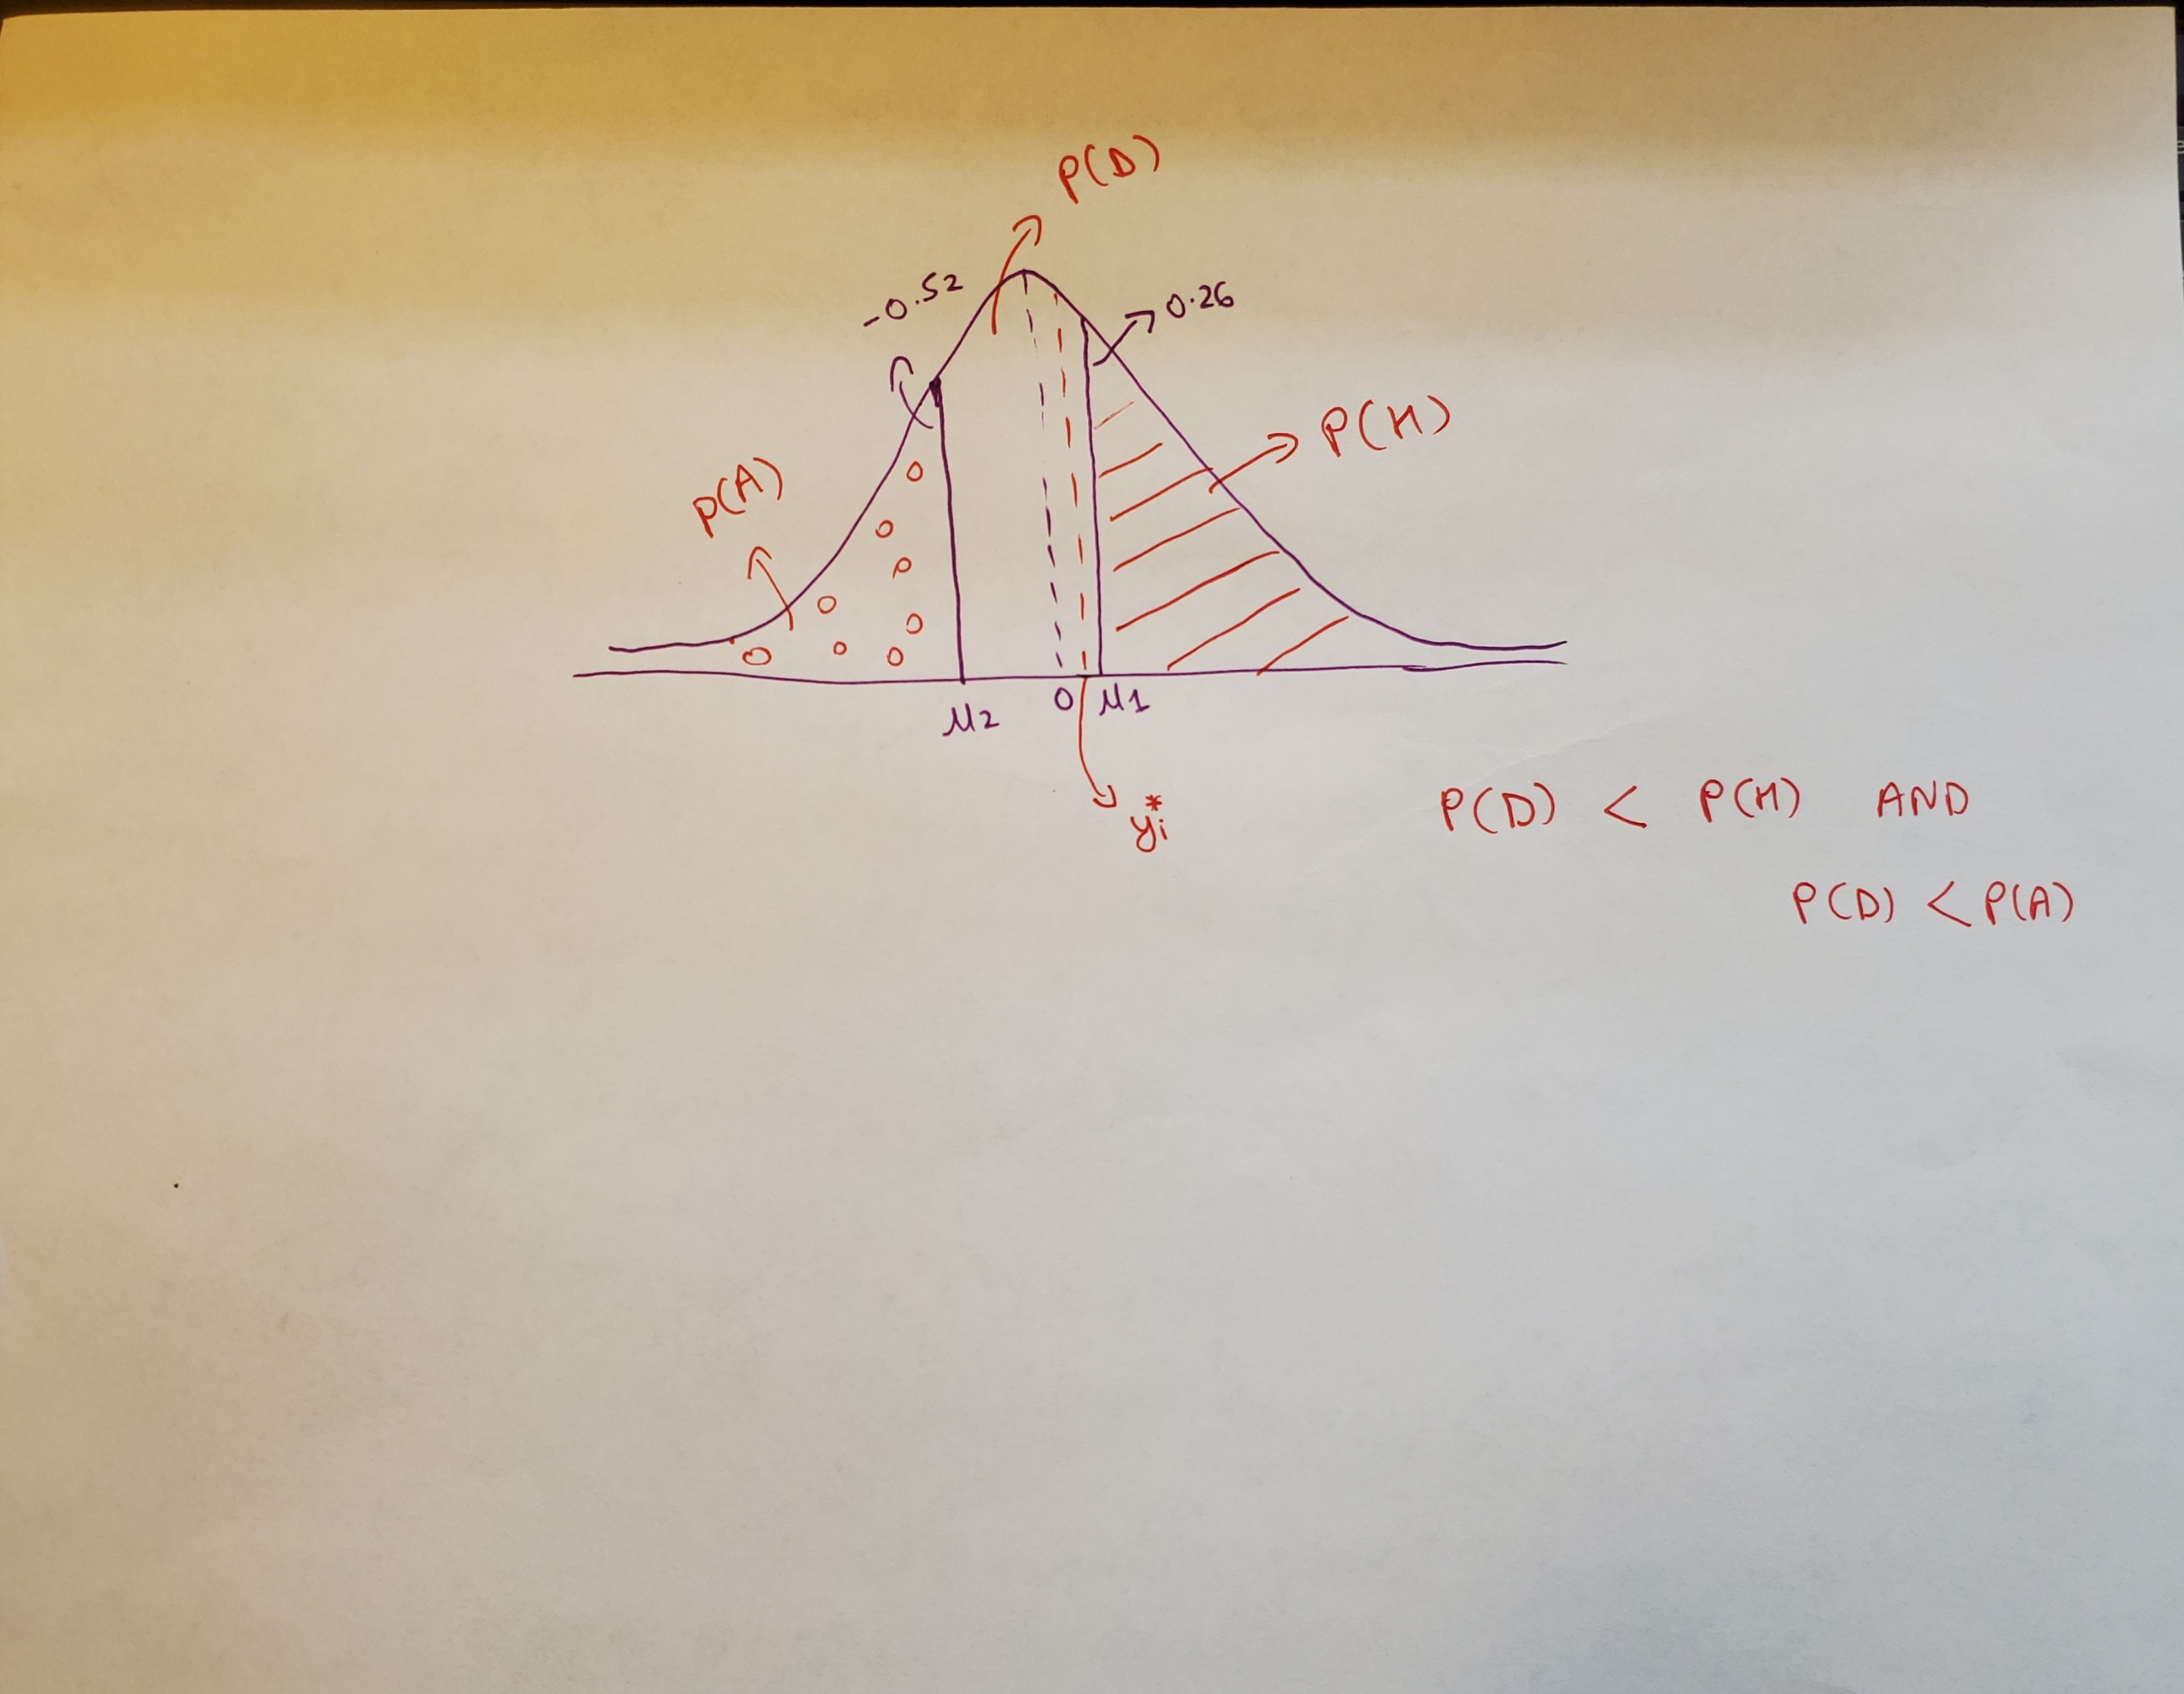
Should Ordered Probit Model Predict Draw?

Slide 37
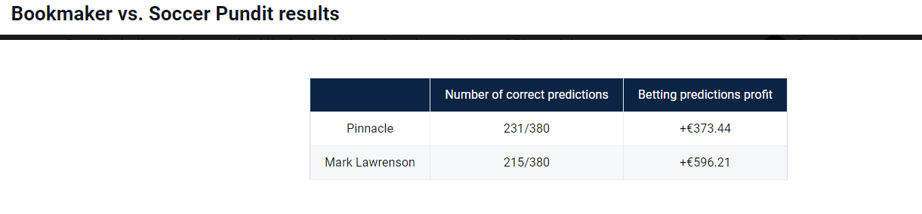
Mark Lawrenson vs. Pinnacle
Notes:
https://www.pinnacle.com/en/betting-articles/Soccer/part-eight-pinnacle-vs-mark-lawrenson/YM22JWUDA6LX63YA

